Slide 1

Introduction
Human Development University English for Computer Science

Slide 2
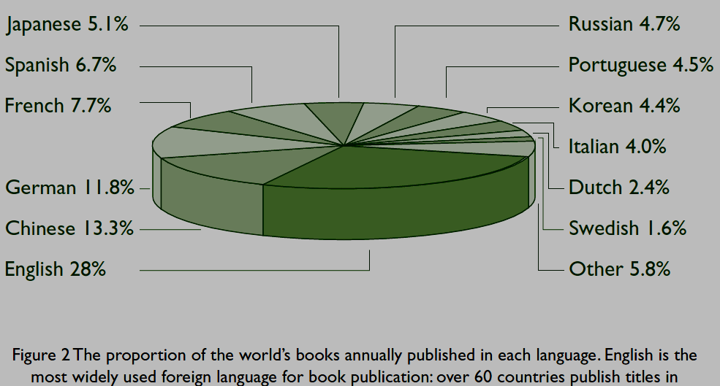
Human Development University English for Computer Science

Slide 3
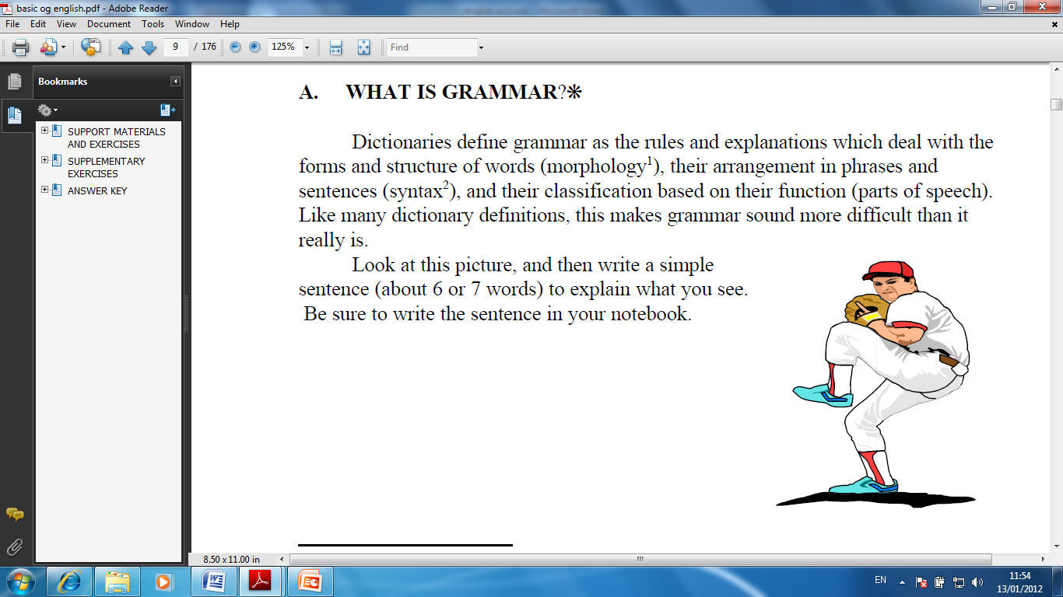
What is grammar
Dictionaries define grammar as the rules and explanations which deal with:
Forms and structure of words (morphology)
Rules to arranging words in to meaningful sentences (syntax)
Look at this picture, and then write
a simple sentence
(about 6 or 7 words) to explain
what you see.
Human Development University English for Computer Science

Slide 4
What is grammar
Your sentence probably looks something like this.
1. The man is throwing the ball.
2. The pitcher is going to throw the ball.
You certainly didn’t write
Ball throwing man the is.
Because you know and have used basic rules of grammar
Human Development University English for Computer Science

Slide 5
Part of speech
Human Development University English for Computer Science

Slide 6
Part of speech
All the words in the English language are divided into eight main classes.
These classes are called the
Parts of Speech.
Human Development University English for Computer Science

Slide 7
Part of speech
Interjection
Pronouns
Conjunctions
Verbs
Adverbs
Nouns
Prepositions
Adjective
Human Development University English for Computer Science

Slide 8
Noun
A noun is the name of any person, thing, animal, place or idea.
As practically anything in the universe has a name, and as there are many things in the universe, nouns comprise the largest group of words in English.
Human Development University English for Computer Science

Slide 9
Noun
Noun names Examples
a person a teacher, a man, Peter, Sara,
a Frenchman, the Queen
a thing a pencil, a computer, a hamburger
an animal or plant a cat, an elephant, pineapple
a place Paris, London, home, Africa, church,
school, airport
an idea love, freedom, education
Human Development University English for Computer Science

Slide 10
Kinds of Nouns
Proper nouns
Common nouns
Concrete nouns
Abstract nouns
Possessive nouns
Plural nouns
Human Development University English for Computer Science

Slide 11
Proper Noun
A noun is the name of any person, place or thing as John, London or book. But what is a Proper noun?
A Proper noun always begins with a capital letter, such as John or London - NAME of specific things, people or places
Human Development University English for Computer Science

Slide 12
List of Proper Noun
This list of English examples will prove useful when learning about different parts of speech:
John, London, Paris, January, September, Monday, Friday, River Thames, Mexican, New Orleans, New York, United Nations, etc.
Human Development University English for Computer Science

Slide 13
Common Nouns
A Common noun always begins with a small letter (unless it is at the beginning of a sentence).
A common or general word. An example of the common noun:
A girl and her dog played in the park.
cat, dog ,boy, girl, park, table, chair, cake, chocolate, etc.
Human Development University English for Computer Science

Slide 14
Common and Proper Noun
This list of examples will clarify the difference between a common and a proper noun:
The teacher is called John .
The nurse is called Nicky.
They come from a country called England.
They live in a country called France.
John and Nicky drink coffee from Starbucks.
They eat burgers from McDonalds .
Human Development University English for Computer Science

Slide 15
A Concrete noun is classified by its ability to reach the senses. Concrete nouns are something physical. If you can taste, touch, hear, smell or see an item the word is a concrete noun.
Examples of concrete nouns are water, air, pizza, bread, juice, fish, perfume, cake, car, toast, etc.
Concrete Noun
Human Development University English for Computer Science

Slide 16
Abstract Noun
An abstract noun means the opposite to a concrete noun. If you cannot taste, touch, hear, smell or see something it is an abstract noun.
Examples of abstract nouns are:
honesty, loyalty, beauty, education, pleasure, skill, courage, revenge, love, hate, freedom ,wisdom, etc.
Human Development University English for Computer Science

Slide 17
Possessive Noun
A possessive noun shows ownership (having or owning). Possessive nouns are formed by adding an apostrophe and "s" or only an apostrophe (‘).
Examples:
John's car.
Human Development University English for Computer Science

Slide 18
Plural Noun
A Plural noun means more than one item. Examples of plural nouns are beds, boys, girls, books and cats.
They are created by adding a letter 's' to the end of a word or by adding 'es' such as in churches, boxes or witches.
Human Development University English for Computer Science

Slide 19
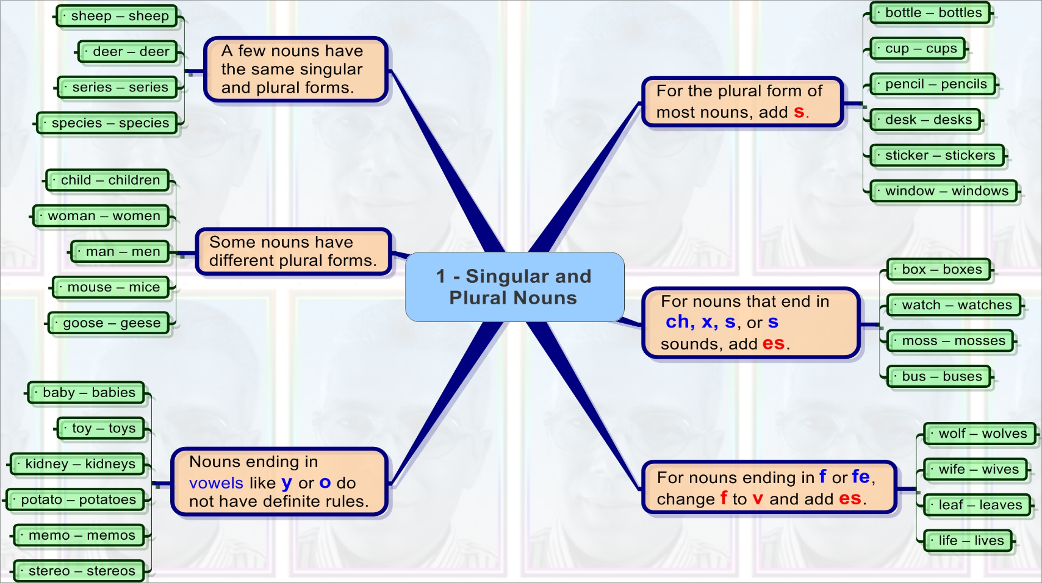
Plural Noun
Human Development University English for Computer Science

Slide 20
Verbs
A verb is a word that expresses action or a state of being.
As you can see from the above definition, there are two main categories of verbs: those that express action and linking verbs.
Human Development University English for Computer Science

Slide 21
Main verb
Because action verbs and linking verbs are strong enough to be used in sentences all by themselves, they are called main verbs.
I love cheese. (action verb)
I am a teacher. (linking verb)
Human Development University English for Computer Science

Slide 22
Auxiliary verb
Auxiliary verbs are used together with a main verb to give grammatical information and therefore add extra meaning to a sentence.
Be, Do and Have are auxiliary verbs.
Modal verbs are also auxiliary verbs, but will be treated separately.
Human Development University English for Computer Science

Slide 23
Pronouns
A word that can function as a noun phrase used by itself and that refers either to the participants in the discourse (e.g. I, you ) or to someone or something mentioned elsewhere in the discourse (e.g. she, it, this ).
Human Development University English for Computer Science

Slide 24
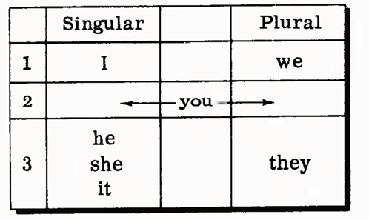
Pronouns
Human Development University English for Computer Science

Slide 25
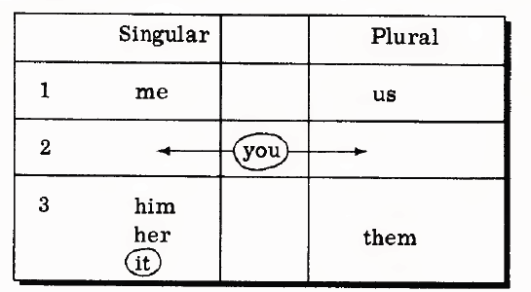
Object form of Pronouns
Human Development University English for Computer Science

Slide 26
Object form of Pronouns
She told them the truth. (them is the object of the verb told)
Sarah hit me on the arm. (me is the object of the verb hit)
He gave me a trombone. (me is the object of the verb gave)
How about this?
She will graduate tomorrow.
Don't make faces at me now because I am trying to be serious
Human Development University English for Computer Science

Slide 27
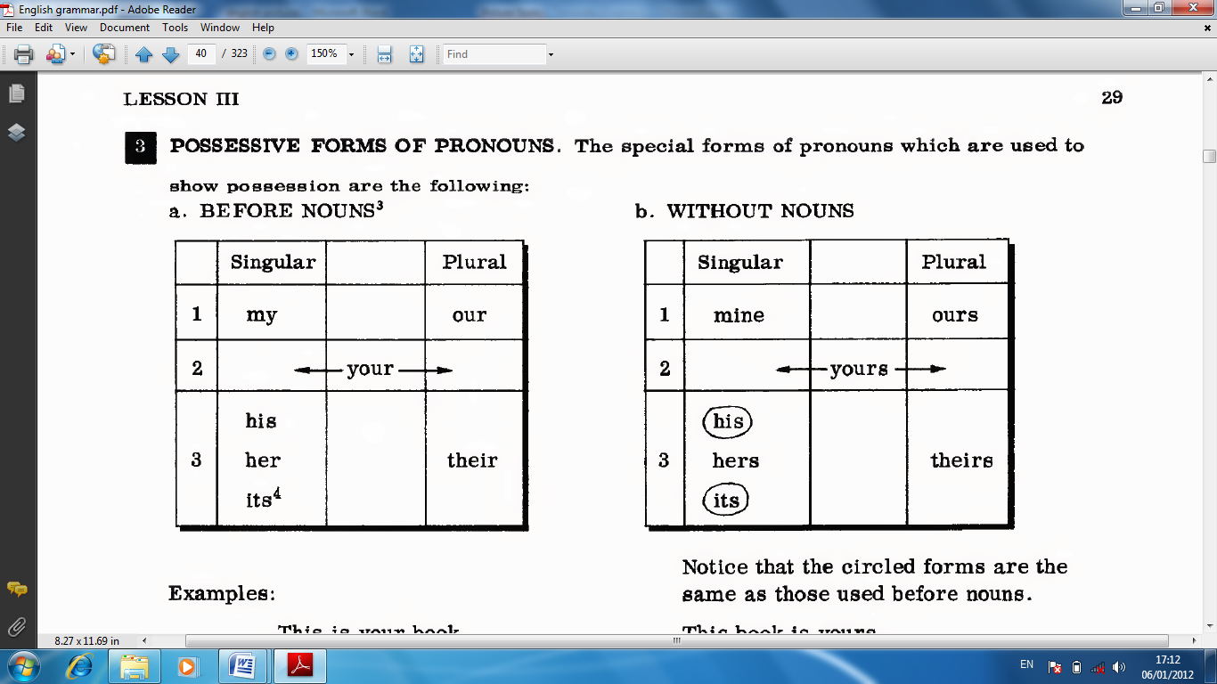
Possessive form of Pronouns
A pronoun indicating possession ( demonstrate ownerships ).
Human Development University English for Computer Science

Slide 28
Possessive form of Pronouns
Singular form
This is my pen →This is mine.
That is your vehicle →That is yours.
Is this your house?→Is this yours?
Plural form
This is our lab→ This is ours.
This is your class→ This is yours.
Human Development University English for Computer Science

Slide 29
Possessive form of Pronouns
I saw her book on your table.
His hair is longer than hers.
The kids are yours, mine, and ours.
Their mocking of him was inappropriate.
I appreciate your understanding of the matter.
The house is theirs and its paint is flaking .
Human Development University English for Computer Science

Slide 30
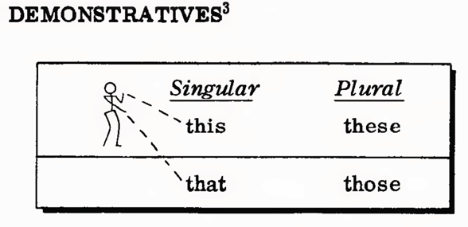
Pronoun: Demonstrative
Human Development University English for Computer Science

Slide 31
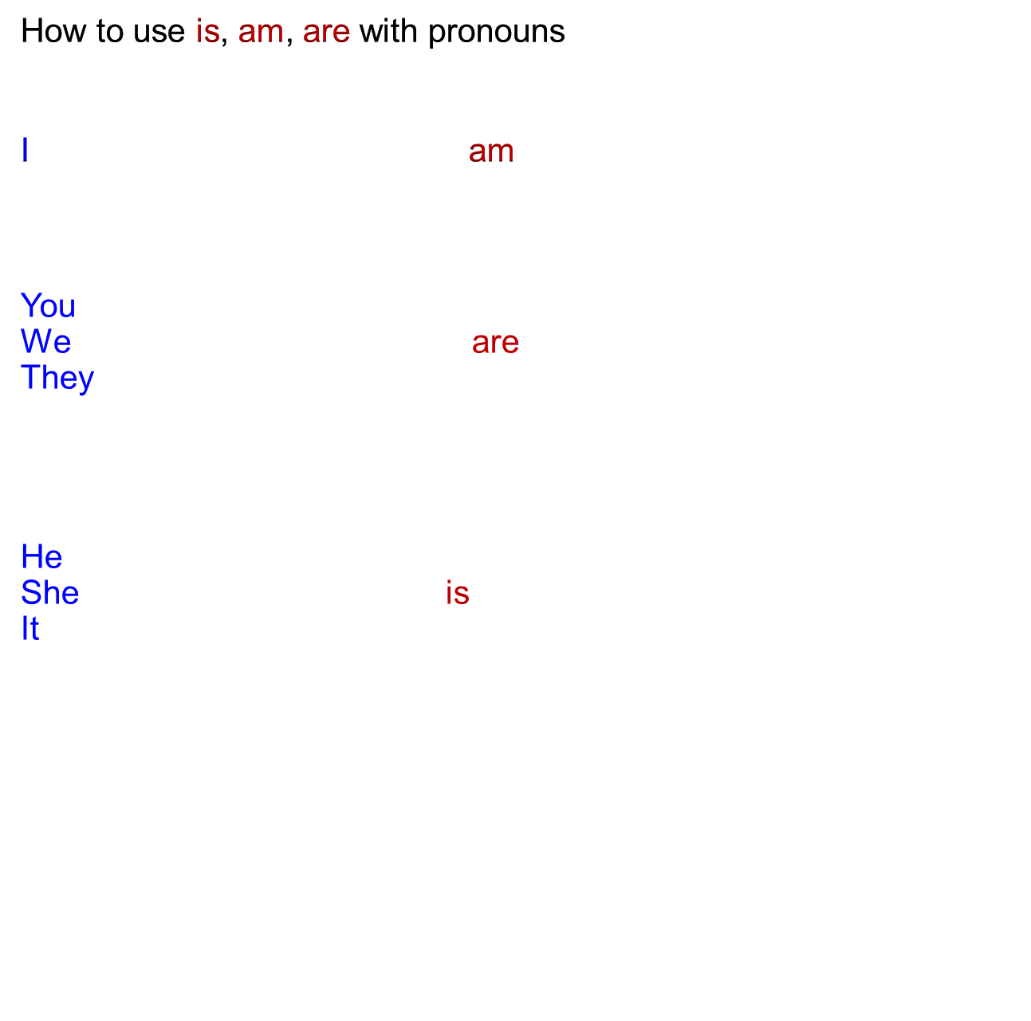
Pronoun
Human Development University English for Computer Science

Slide 32
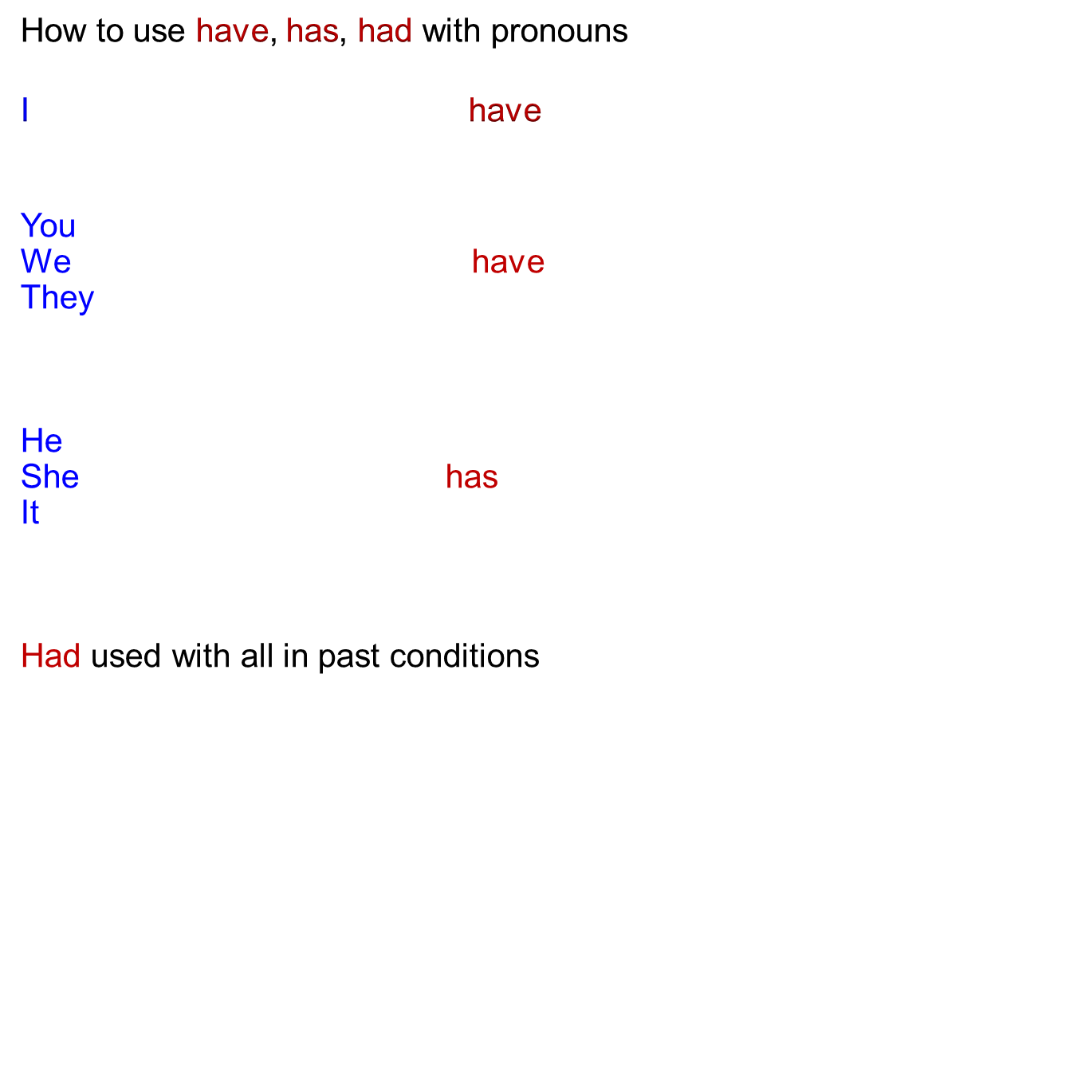
Pronoun
Human Development University English for Computer Science

Slide 33
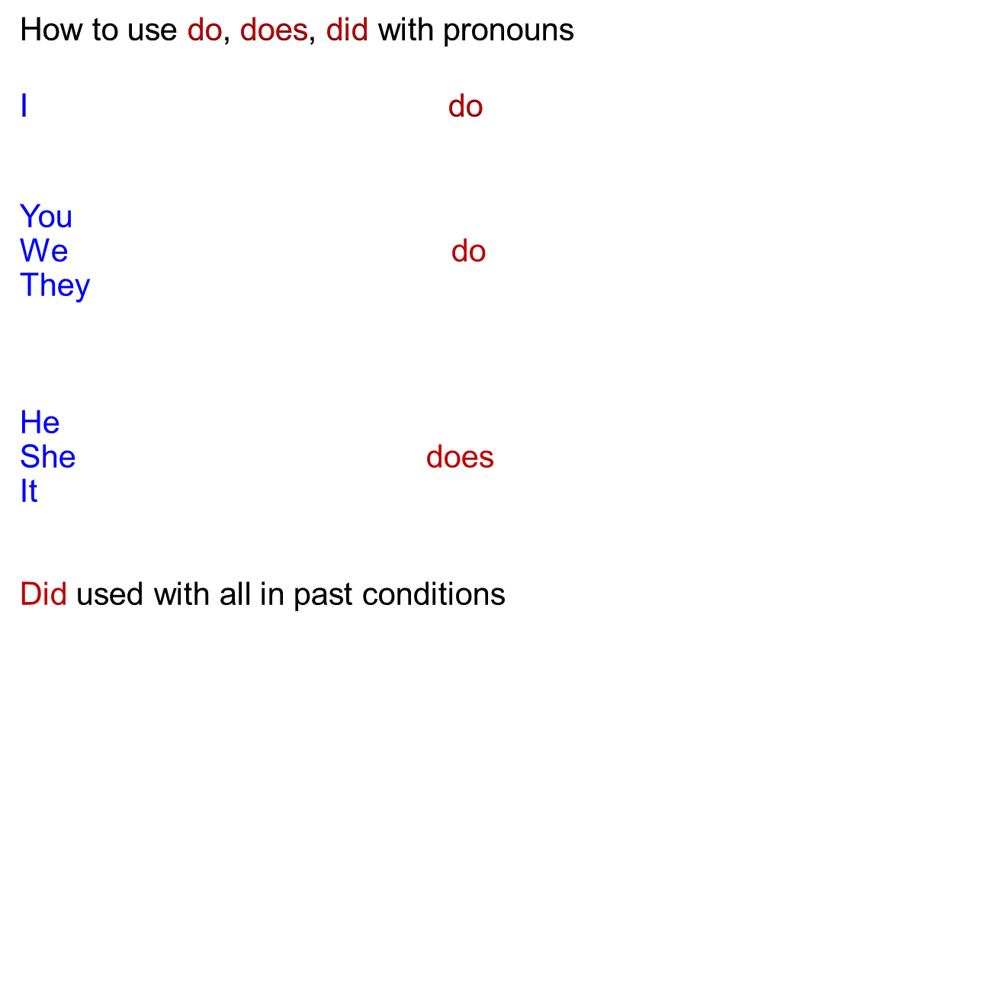
Pronoun
Human Development University English for Computer Science

Slide 34
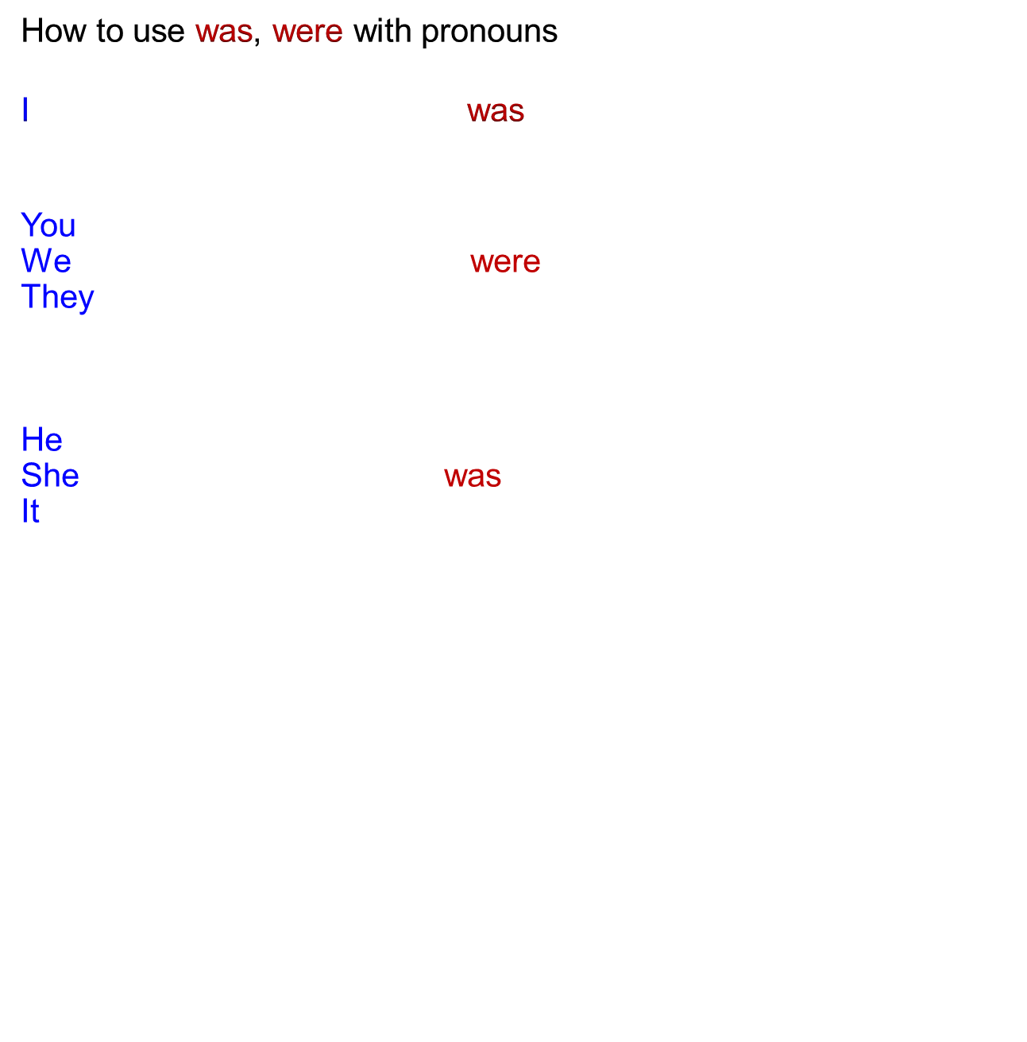
Pronoun
Human Development University English for Computer Science

Slide 35
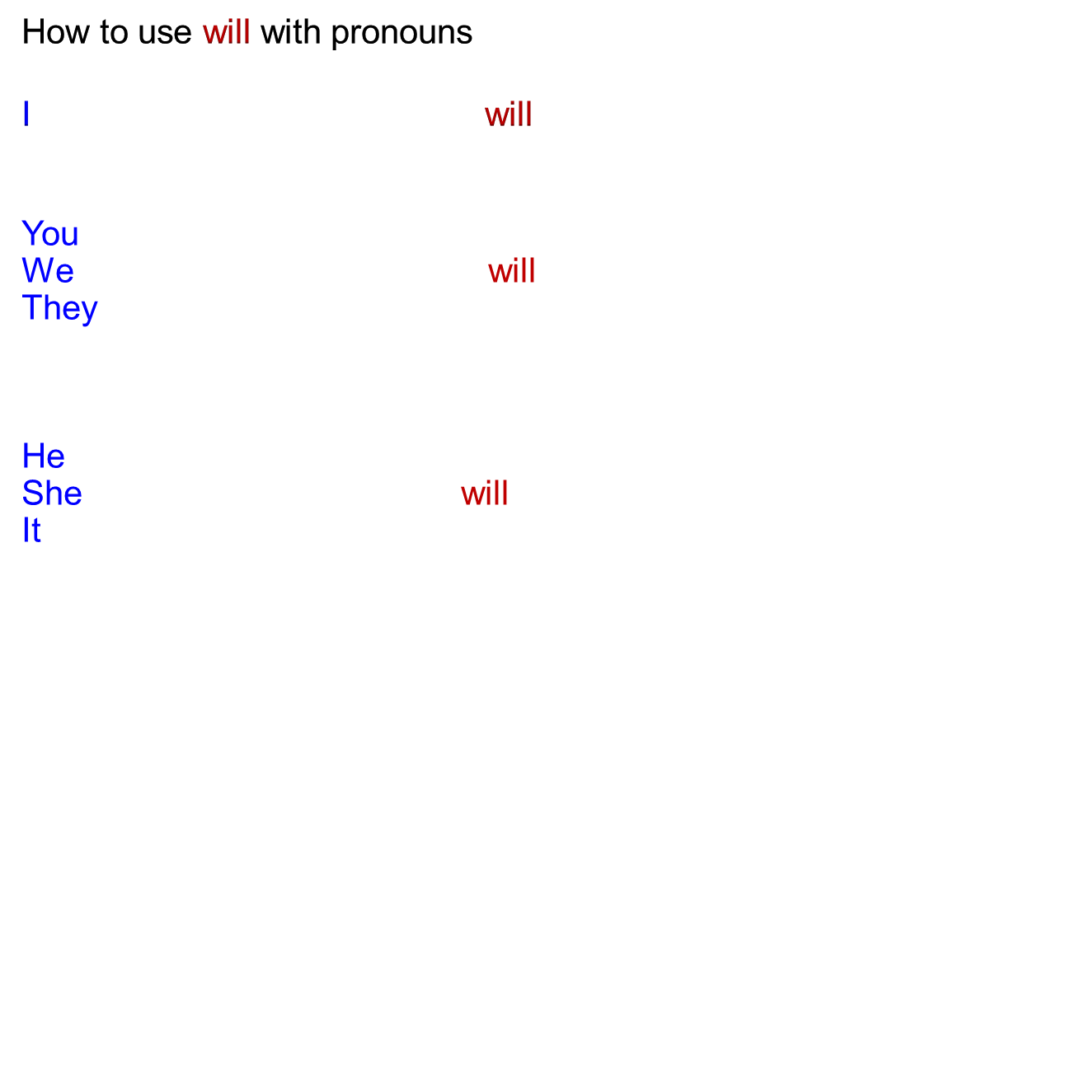
Pronoun
Human Development University English for Computer Science

Slide 36
Adjective
An adjective is a word that modifies (describes) a noun or pronoun.
Adjectives inform about the qualities and features of people, things or concepts (big, strong, beautiful, sensitive) and can be considered as "decoration" to the required basic sentence elements, adding variety and liveliness.
Human Development University English for Computer Science

Slide 37
Adjective
In the following examples, the adjectives are underlined and the nouns or pronouns they modify are in bold.
He was happy when he moved to his new house.
[the adjective happy modifies the pronoun he, the adjective new modifies the noun house]
Human Development University English for Computer Science

Slide 38
Adverb
An adverb is a type of word that has many uses in English. It can modify (describe) a verb, an adjective, another adverb, or a whole sentence.
Adverbs (quickly, here, now, always, very, obviously) can be considered as "decoration" to the required basic sentence elements, supplement them with important pieces of information.
Human Development University English for Computer Science

Slide 39
Adverb
In the following examples, the adverbs are underlined and the elements they modify are in bold.
The new typist works quickly and well.
[the adverbs quickly and well modify the verb works]
The new typist is extremely busy.
[the adverb extremely modifies the adjective busy]
The new typist works very quickly.
[the adverb very modifies the adverb quickly]
Human Development University English for Computer Science

Slide 40
Adverb
Adverbs can be divided into the following groups of types, each answering the below mentioned questions:
Adverb of manner - how?
Examples: quietly, happily, sadly, quickly, slowly, well
Adverbs of place - where?
Examples: away, at home, down, everywhere, round, here, there
Human Development University English for Computer Science

Slide 41
Adverb
Adverbs can be divided into the following groups of types, each answering the below mentioned questions:
Adverb of time - when?
Examples: daily, last week, a year ago, tomorrow, on Sunday, immediately
Adverb of frequency - how often ?
Examples: always, often, usually, sometimes, seldom, never
Adverbs of degree - how much ?
Examples: quite, rather, pretty, very, completely, really, hardly, too, just
Human Development University English for Computer Science

Slide 42
Preposition
A preposition is a word that conveys relationships between other words, usually in time, place or direction.
That man with the hat always dresses well.
With is a preposition that shows the relationship between the noun hat and the man. Hat is the object of the preposition with.
Human Development University English for Computer Science

Slide 43
Preposition
About above across after against around at before behind below beneath beside besides between beyond by down during except for from in inside into like near of off on out outside over since through throughout till to toward under until up upon with without according to because of
by way of in addition to in front of in place of
in regard to in spite of instead of on account of out of
Human Development University English for Computer Science

Slide 44
Conjunction
A conjunction is a word that connects other words, phrases and clauses reflecting some kind of logical relationship between the connected elements .
coordinating conjunctions
Examples: and, or, but, so, or, nor, for, yet
subordinating conjunctions
Examples: because, since, while, after, if, although, as,as if,
correlative conjunctions
Examples: not only...but also, either...or, neither...nor, both...and
Human Development University English for Computer Science

Slide 45

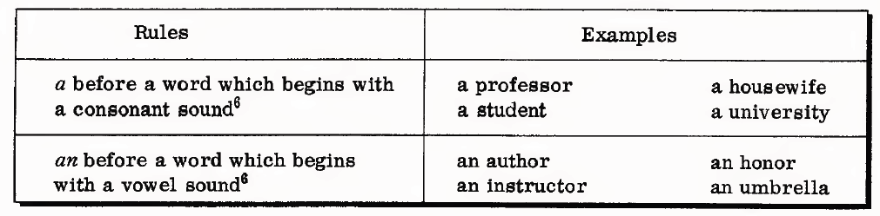

The is used to indicate that something is known or has been mentioned before.
Human Development University English for Computer Science

